Slide 1
K.I.E.T GROUP OF INSTITUTIONS GHAZIABAD
Crypto Currency App
ALPHAGRAPHY
MENTOR- Vanshita Gupta
Prof. Naresh Chandra Nitin Goyal
Anuj Goel
Hritick Varshney

Slide 2
Project Objective
The Project aims to build an application that provides people all the latest news of Digital Currency , exchanges news , live price of coins , fundamentals of different currencies , Charts of cryptos and in future will also be used in Paper Trading.

Slide 3
Project Description
The Project titled as ALPHAGRAPHY and is used to show various artefact of all the Digital Currency. Alphagraphy is the name of Application built for various O/S which helps the user to know indepth details of currency, it includes Charts , price fluctuation , Rates in different worldwide used currencies , News of exchanges , News related to Virtual Currency etc. Thus it help the people to get quick overview of market, helps them in better decision making , Moreover it help the people to grow their income.

Slide 4
Requirements
Software Requirements
Operating system: window 7 & above.
Client: Chrome, Firefox, Opera mini
Hardware requirements
Processor: MT6762(HELIO P22) or above
Ram: minimum 20 mb
Storage: minimum 20mb – 50 mb

Slide 5

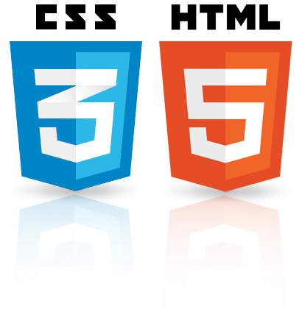


Technology
HTML & CSS, Javascript , RapidAPI’S, REACT , Redux , ant design, chart.js , Bing.js and

Slide 6
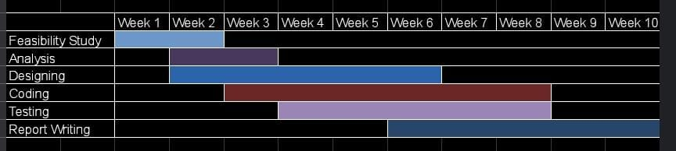
Gantt Chart

Slide 7
Thankyou

